Slide 1


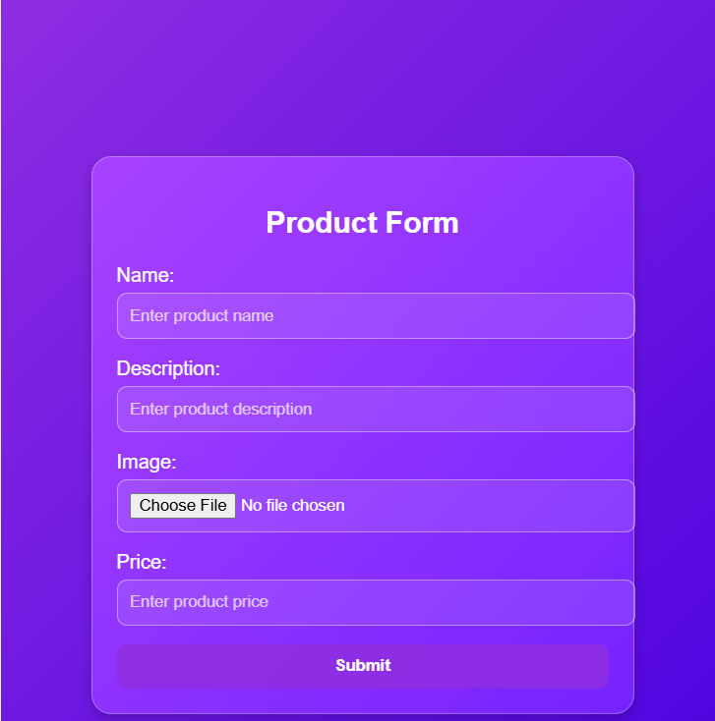
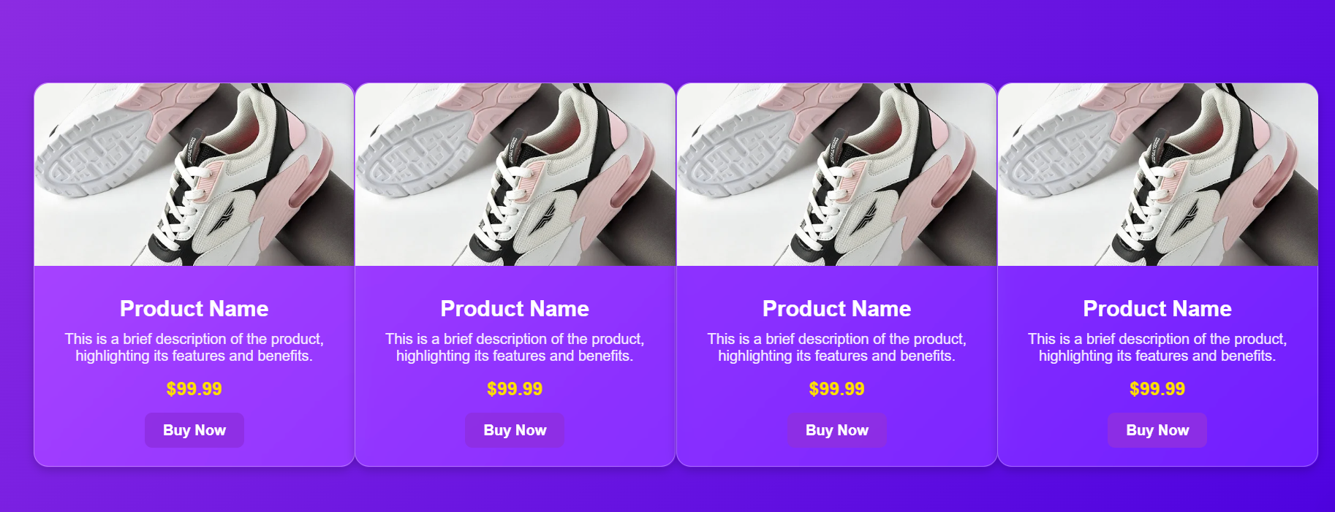
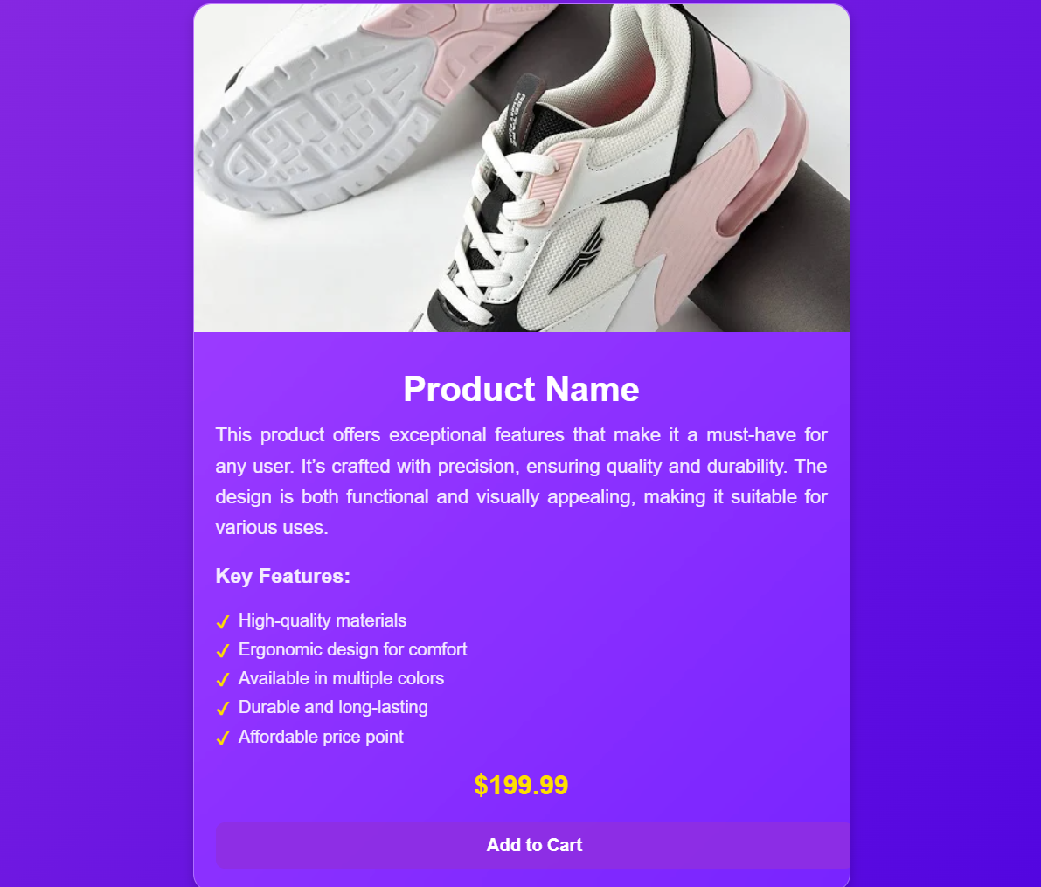
Item Showcase Hub
Step-1:Setup Django Project & App
Set Up Media Folder & Define Item Model
Step-2: Create Forms for Item Submission as Shown follow
Step-3: Design the Homepage with Bootstrap Cards
Apply Bootstrap Styling For responsive layout and design
Step-4: Link to Detailed View

